Slide 1
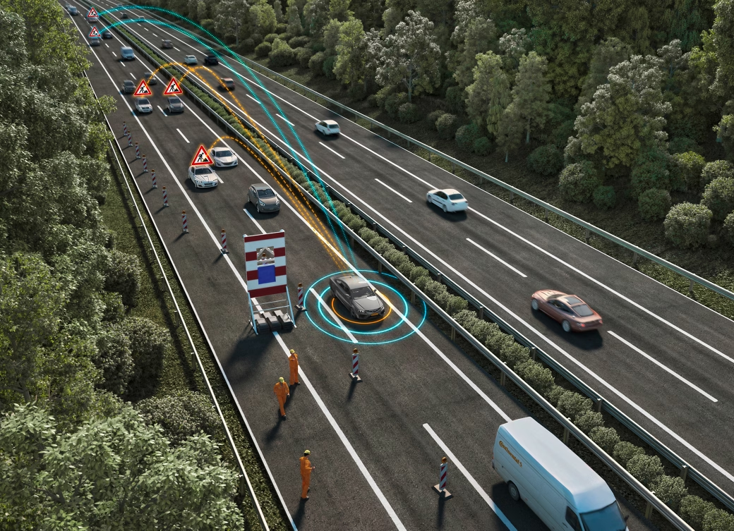






Anonymous Authentication in V2X
Secure Communication Methods Explained
Team Members:
Anirudh Bansal - RA2211003011208
Adittya Sengupta - RA2211003011215
Rushil Ghetiya - RA2211003011217

Slide 2




Introduction to V2X Communication
Exploring the security challenges in V2X systems
Key Components of V2X Technology
Major Security Threats in V2X
Vehicles communicate with infrastructure
Data privacy concerns

Slide 3

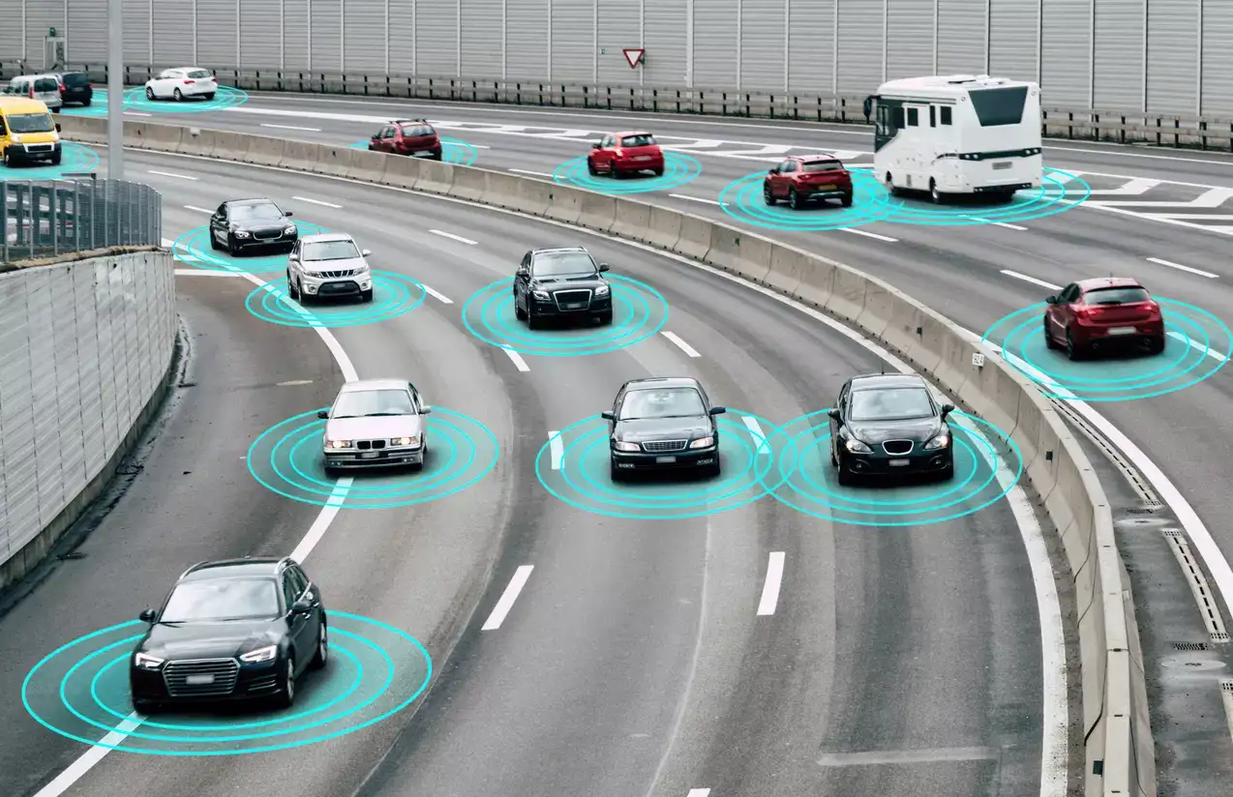



Understanding V2X Communication
V2X communication enables vehicles to exchange information with each other and infrastructure, enhancing road safety and traffic efficiency through real-time data sharing and improved awareness of surroundings.

Slide 4

Data Interception Risks
Unauthorized access can lead to sensitive data leaks.
Security and Privacy Challenges in V2X
Spoofing Attacks
Malicious entities can send false information to vehicles.
Identity Privacy Issues
Driver identities may be exposed during communication.
Insufficient Authentication Measures
Weak authentication can allow unauthorized vehicle access.

Slide 5

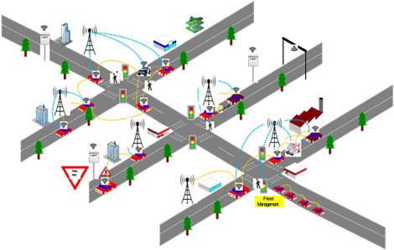


Anonymous Authentication Mechanisms in V2X
Exploring cryptographic techniques to enhance security and privacy in vehicle-to-everything communication systems.

Slide 6

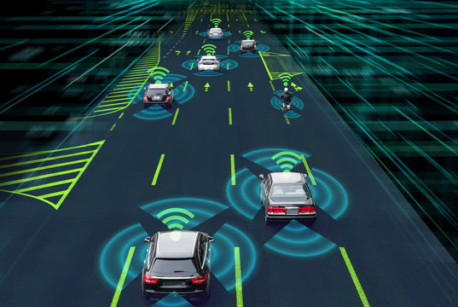
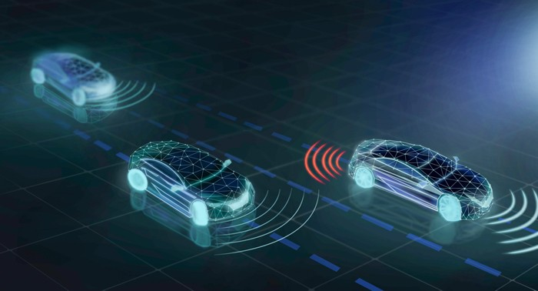

Secure CAM Transmission and Protocol Standards
Standards Overview
Protocol Effectiveness
Various protocols ensure secure vehicle communication.
Evaluating the strength of different V2X protocols.

Slide 7
Simulation Environment Setup for V2X
Overview of tools and configurations used
Tools for Simulation
SUMO for traffic simulation
Configuration Settings
Road network design

Slide 8


5 out of 5
All scenarios successfully tested
90%
High accuracy in results
1,000 vehicles
Total vehicles simulated in tests

Slide 9
Performance Metrics Overview
Evaluation of key performance indicators was conducted for accuracy.
Security Findings
Results and Analysis of V2X
Analysis showed improvements in data protection and user privacy.
Transmission Efficiency
Secure CAM transmission demonstrated significant reductions in latency.
Future Improvements
Recommendations include advanced algorithms for further enhancement of security.

Slide 10
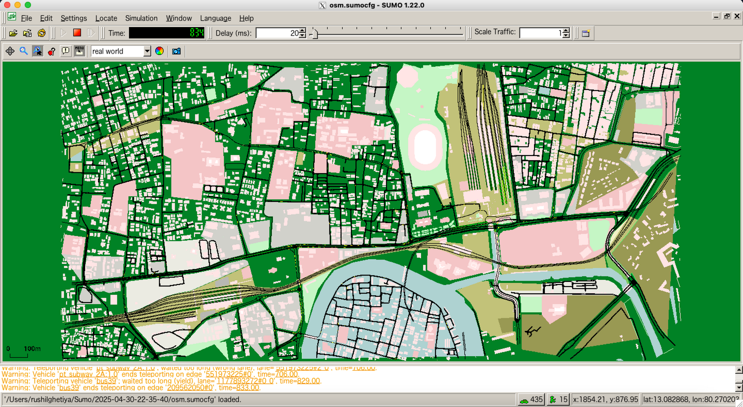
Result!

Slide 11


We'd love to hear from you!
Thank
You!

